Slide 1

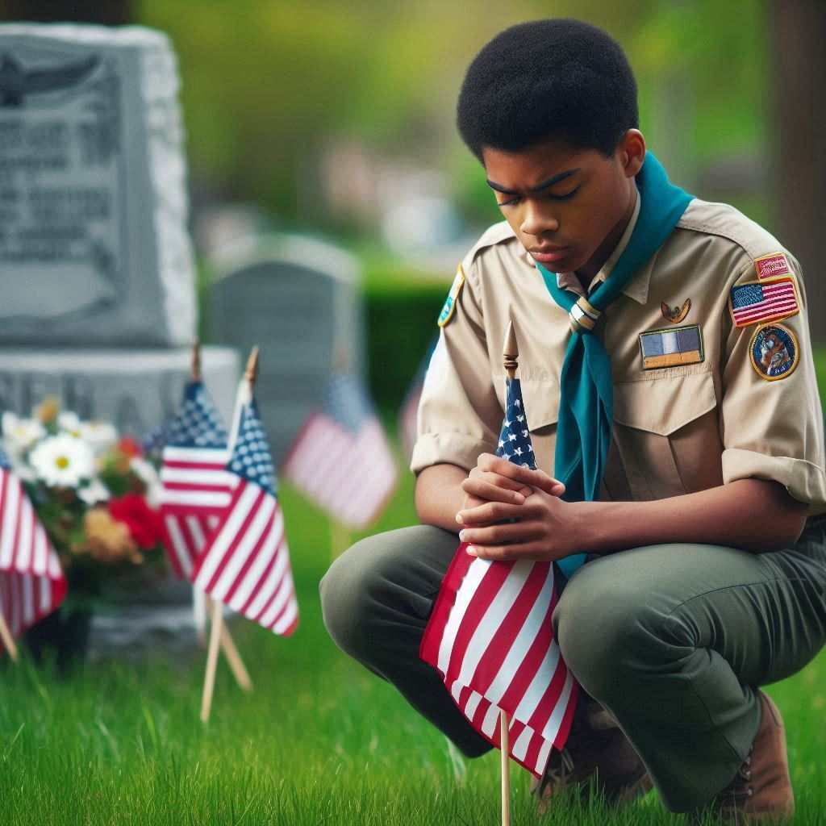
Roundtable Youth Flag Ceremony
Troop/Pack Youth Flag Ceremony
  Pledge, Oath, Law & Outdoor Code
First / Second time participant receives red/white/blue star coups
Third time participant receives red/white/blue loops
See Gail Lavenburg to signup
  816-682-5875, gaill0516@gmail.com
A big thank you to Janet Cookinham for donating the ribbon & sewing the loops!

Slide 2

Help Needed!
DISTRICT CUB SCOUT
ADVANCEMENT CHAIR NEEDED!
If you are interested in applying, contact Ron Adams tonight in the Eagle Project Review area, or by email at SGMRON13250@HOTMAIL.COM

Slide 3

Merit Badge Test Lab
What is the Test Lab
The Scouts BSA Test Lab is an exciting way to help in the development of fun and interesting new topics unique to the Scouts BSA program. The requirements for each badge have the look and feel of merit badges, but instead of a printed pamphlet, you will find links to digital resources to help you complete the requirements.
Scouts BSA Test Lab | Boy Scouts of America
https://www.scouting.org/skills/merit-badges/test-lab/

Slide 4

Sea Scouting Program Updates
Learn about latest updates in the Sea Scout program
Details: https://seascout.org/manual-resource-center/

Slide 5

June Eagle Project Review
Final Eagle Project review until August 7th
Date: Thursday, June 5th
Time: 7 pm
Location: Parkville Presbyterian Church
Questions: SGMRON13250@HOTMAIL.COM

Slide 6
Nominate someone for SOTM
Nominate a worthy Scouter for Scouter of the Month!
If you know a Scouter who has gone above and beyond, get them recognized at Roundtable.
They need not be active at the District or Council level to receive this award.
To nominate someone, go to the Roundtable website:
https://www.northstarkc.com/roundtable
Scroll all the way down and fill in each field.
Please note that only nominations received via the website will be accepted.

Slide 7
SUFS - Training
Hold the date for SUFS Training
Sign Up for Scouting – Training –
Date: August 13th
Time: 6:30 – 8:30
Location: Tentative – Salvation Army
Who Should attend: Anyone in Packs / Troops / Crews and Ships, that would like to learn more about recruitment of new Scouts

Slide 8
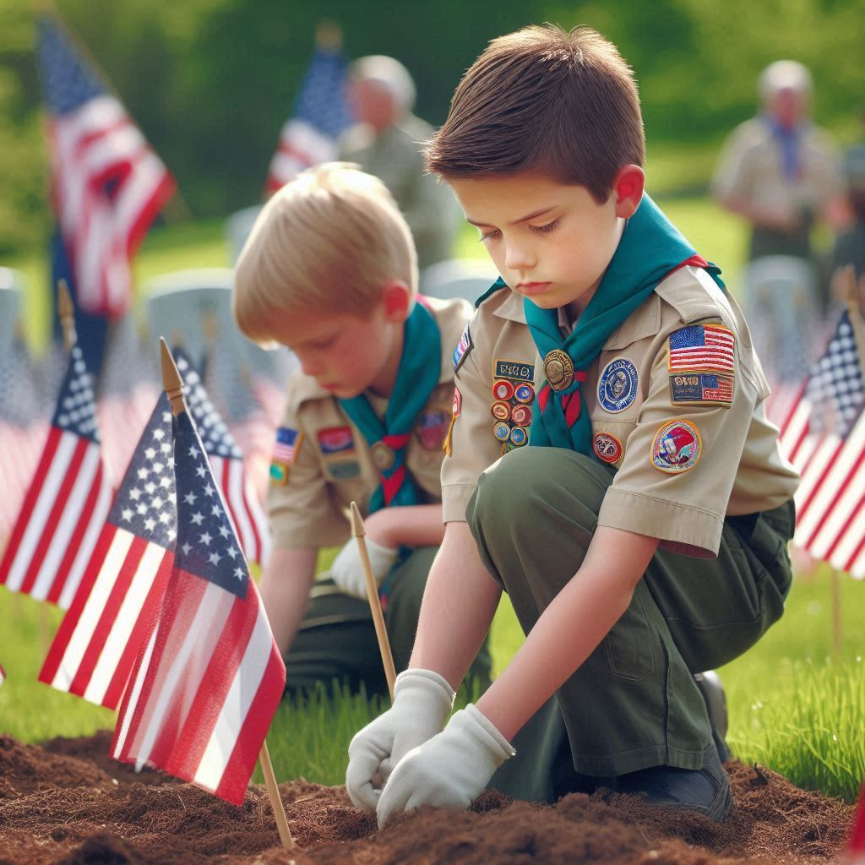
UPCOMING ACTIVITIES
North Star District
Aug 13th - SUFS Training
(Sat) Sep/Oct-2025 Fall Cub Family Camp-Out (Fri Night/Sat Day)
(Sat) Sep/Oct-2025 Camp-O-Ree & Webelos Woods (Fri/Sat/Sun)
HOAC
(Sat) 30-Aug-2025 Scout Night at the Monarchs
(Sat) 08-Nov-2025 Scout Night at the Zoo

Slide 9
UPCOMING TRAINING

Slide 10
UPCOMING TRAINING (CONT.)

Slide 11
UPCOMING TRAINING (CONT.)
Leave No Trace – May 2 – Camp Naish
Fall Intro to Outdoor Leader Skill – Sept 26 – Camp Naish
Leave No Trace Level 1 Instructor Course – Oct 24 – Camp Naish
2025 Council Training Courses (2025)
https://mycouncil.hoac-bsa.org/Program/42

Slide 12
UPCOMING TRAINING (CONT.)
Other training courses available:
  Shotgun Instructor NRA Training
  Pistol Instructor NRA Training
  Range Safety Officer NRA Training
  Basic Instructor NRA Training
  Leave No Trace Level 1 Instructor
  Chainsaw Training
  For all the above courses, go to:
  https://mycouncil.hoac-bsa.org/Program/42

Slide 13
August Meeting
Thursday, August 7
Sign-in at 6:30
Program begins at 7:00
At the Salvation Army Northland Corps & Community Center

Slide 14
OA Service Project
The North Star
OA Chapter – ‘Bo Qui’
Completed a trash pickup on Saturday April 5th

Slide 15
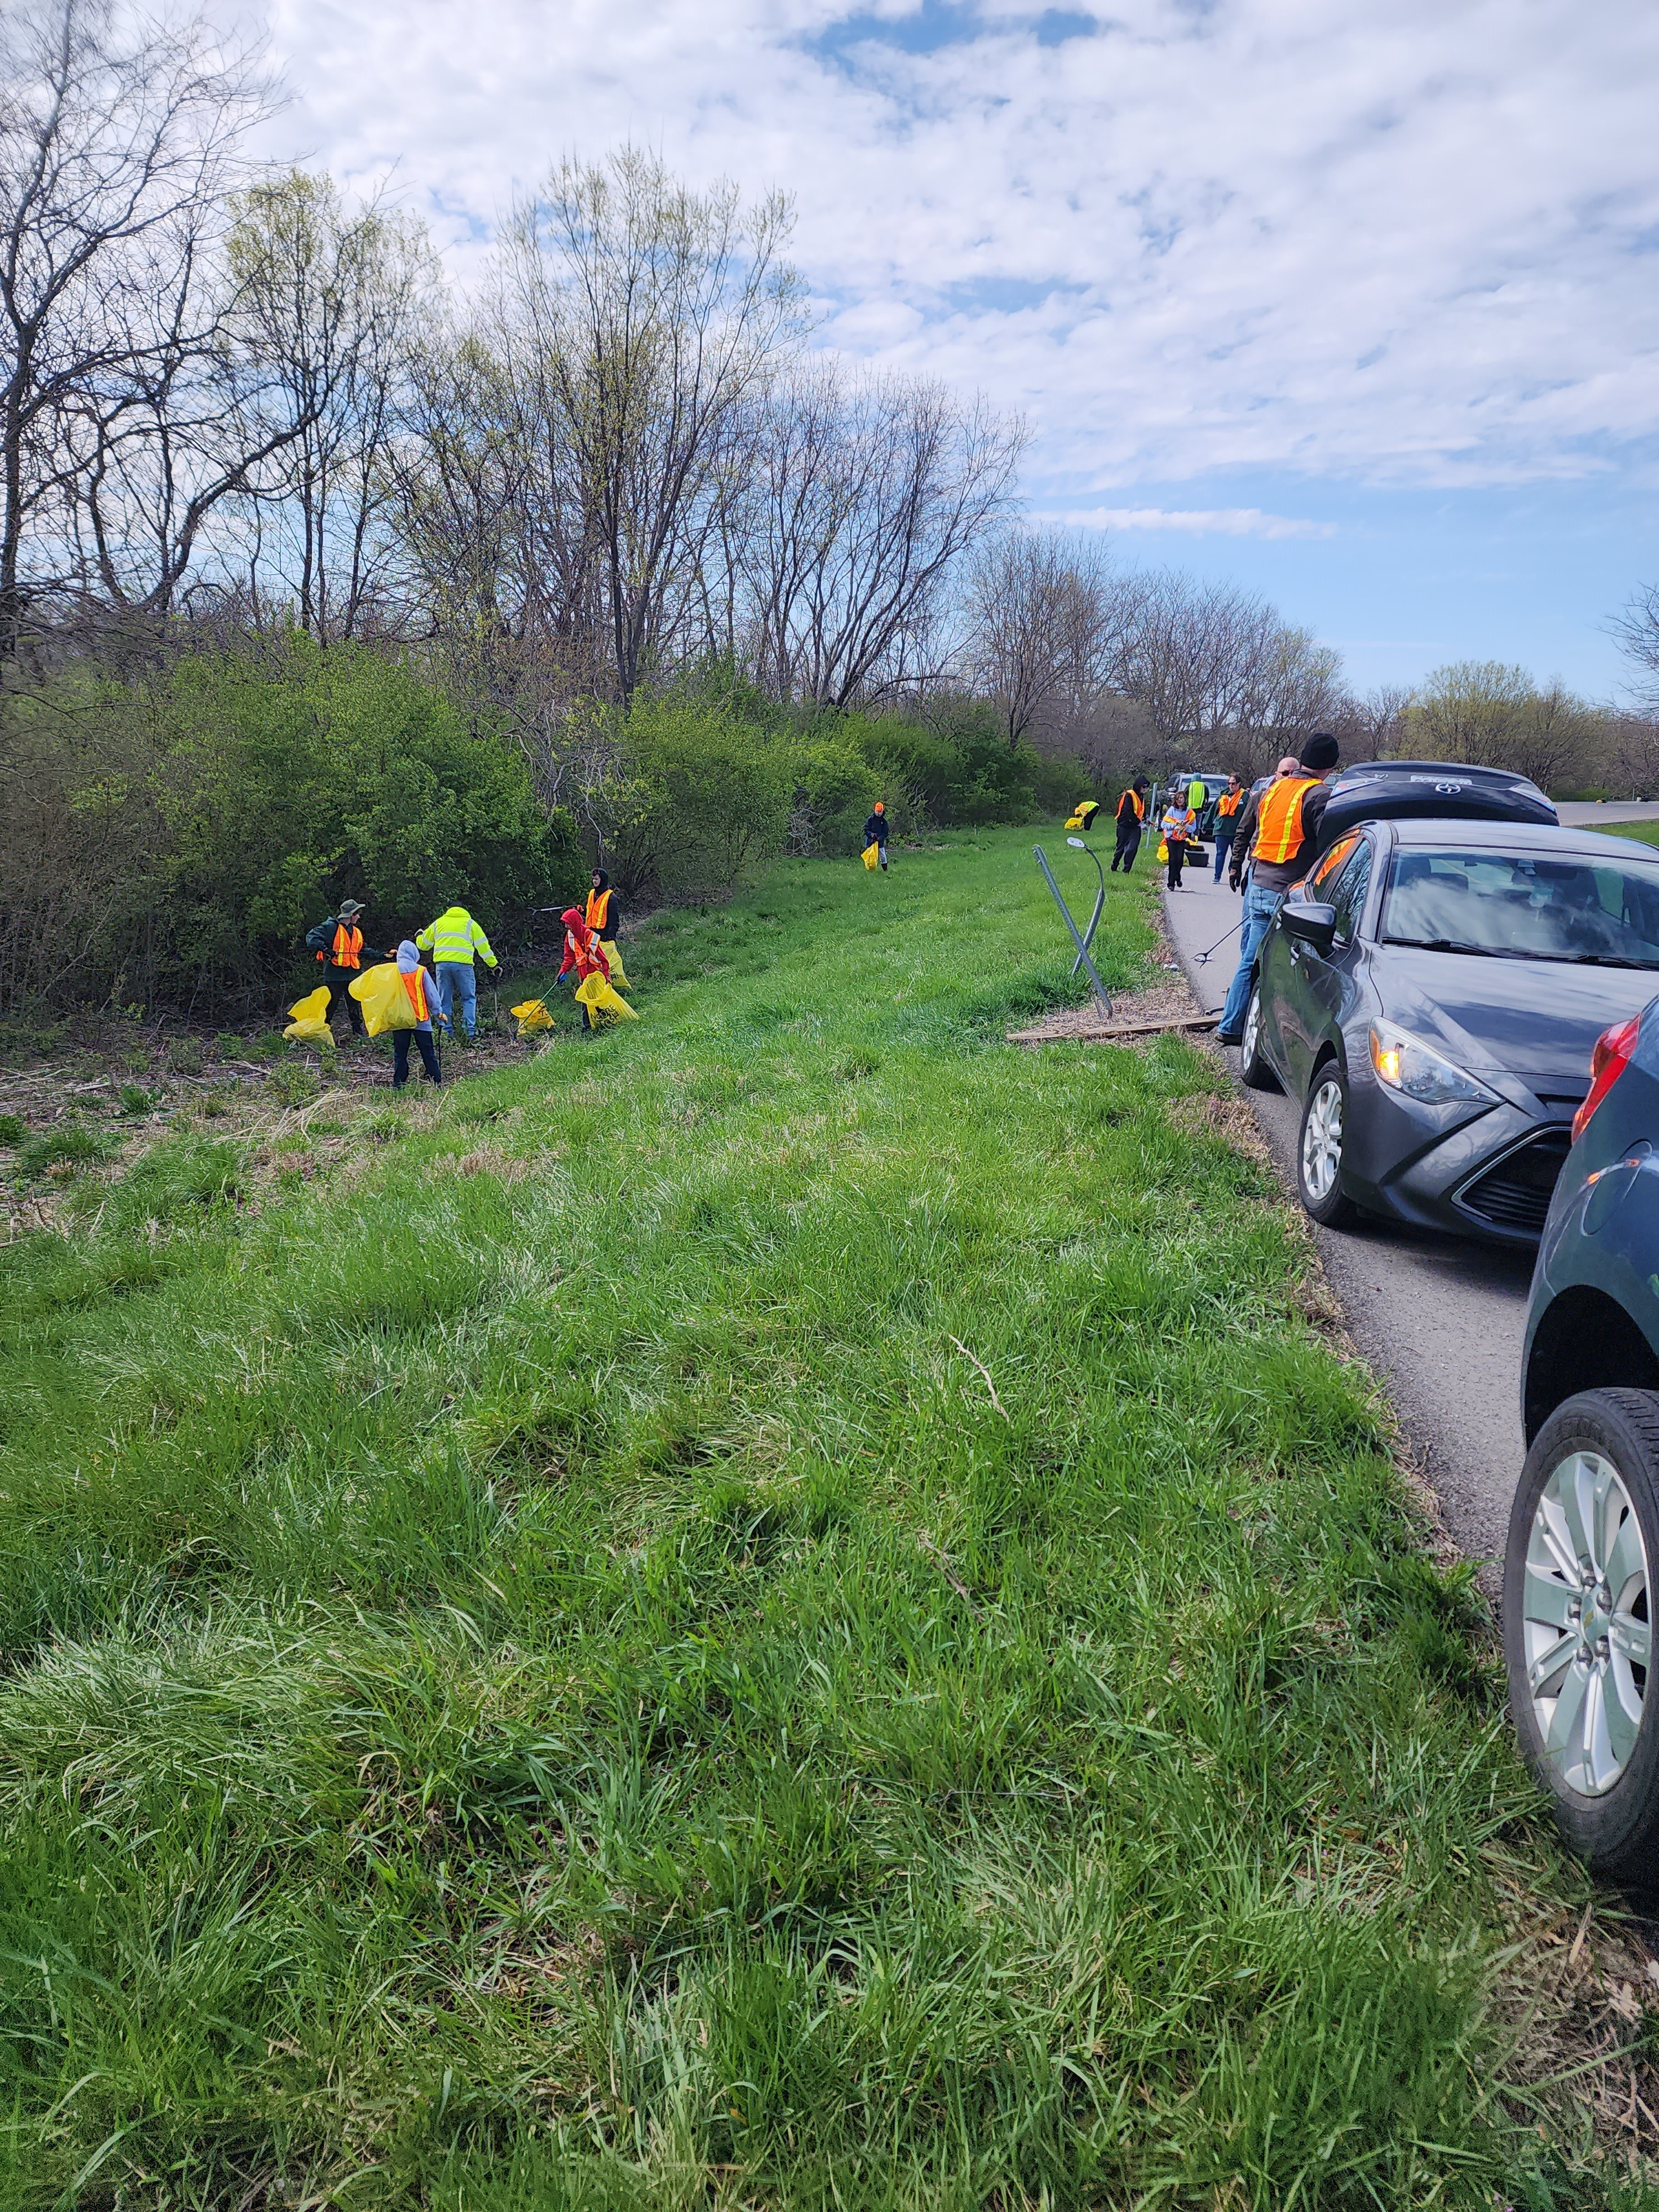
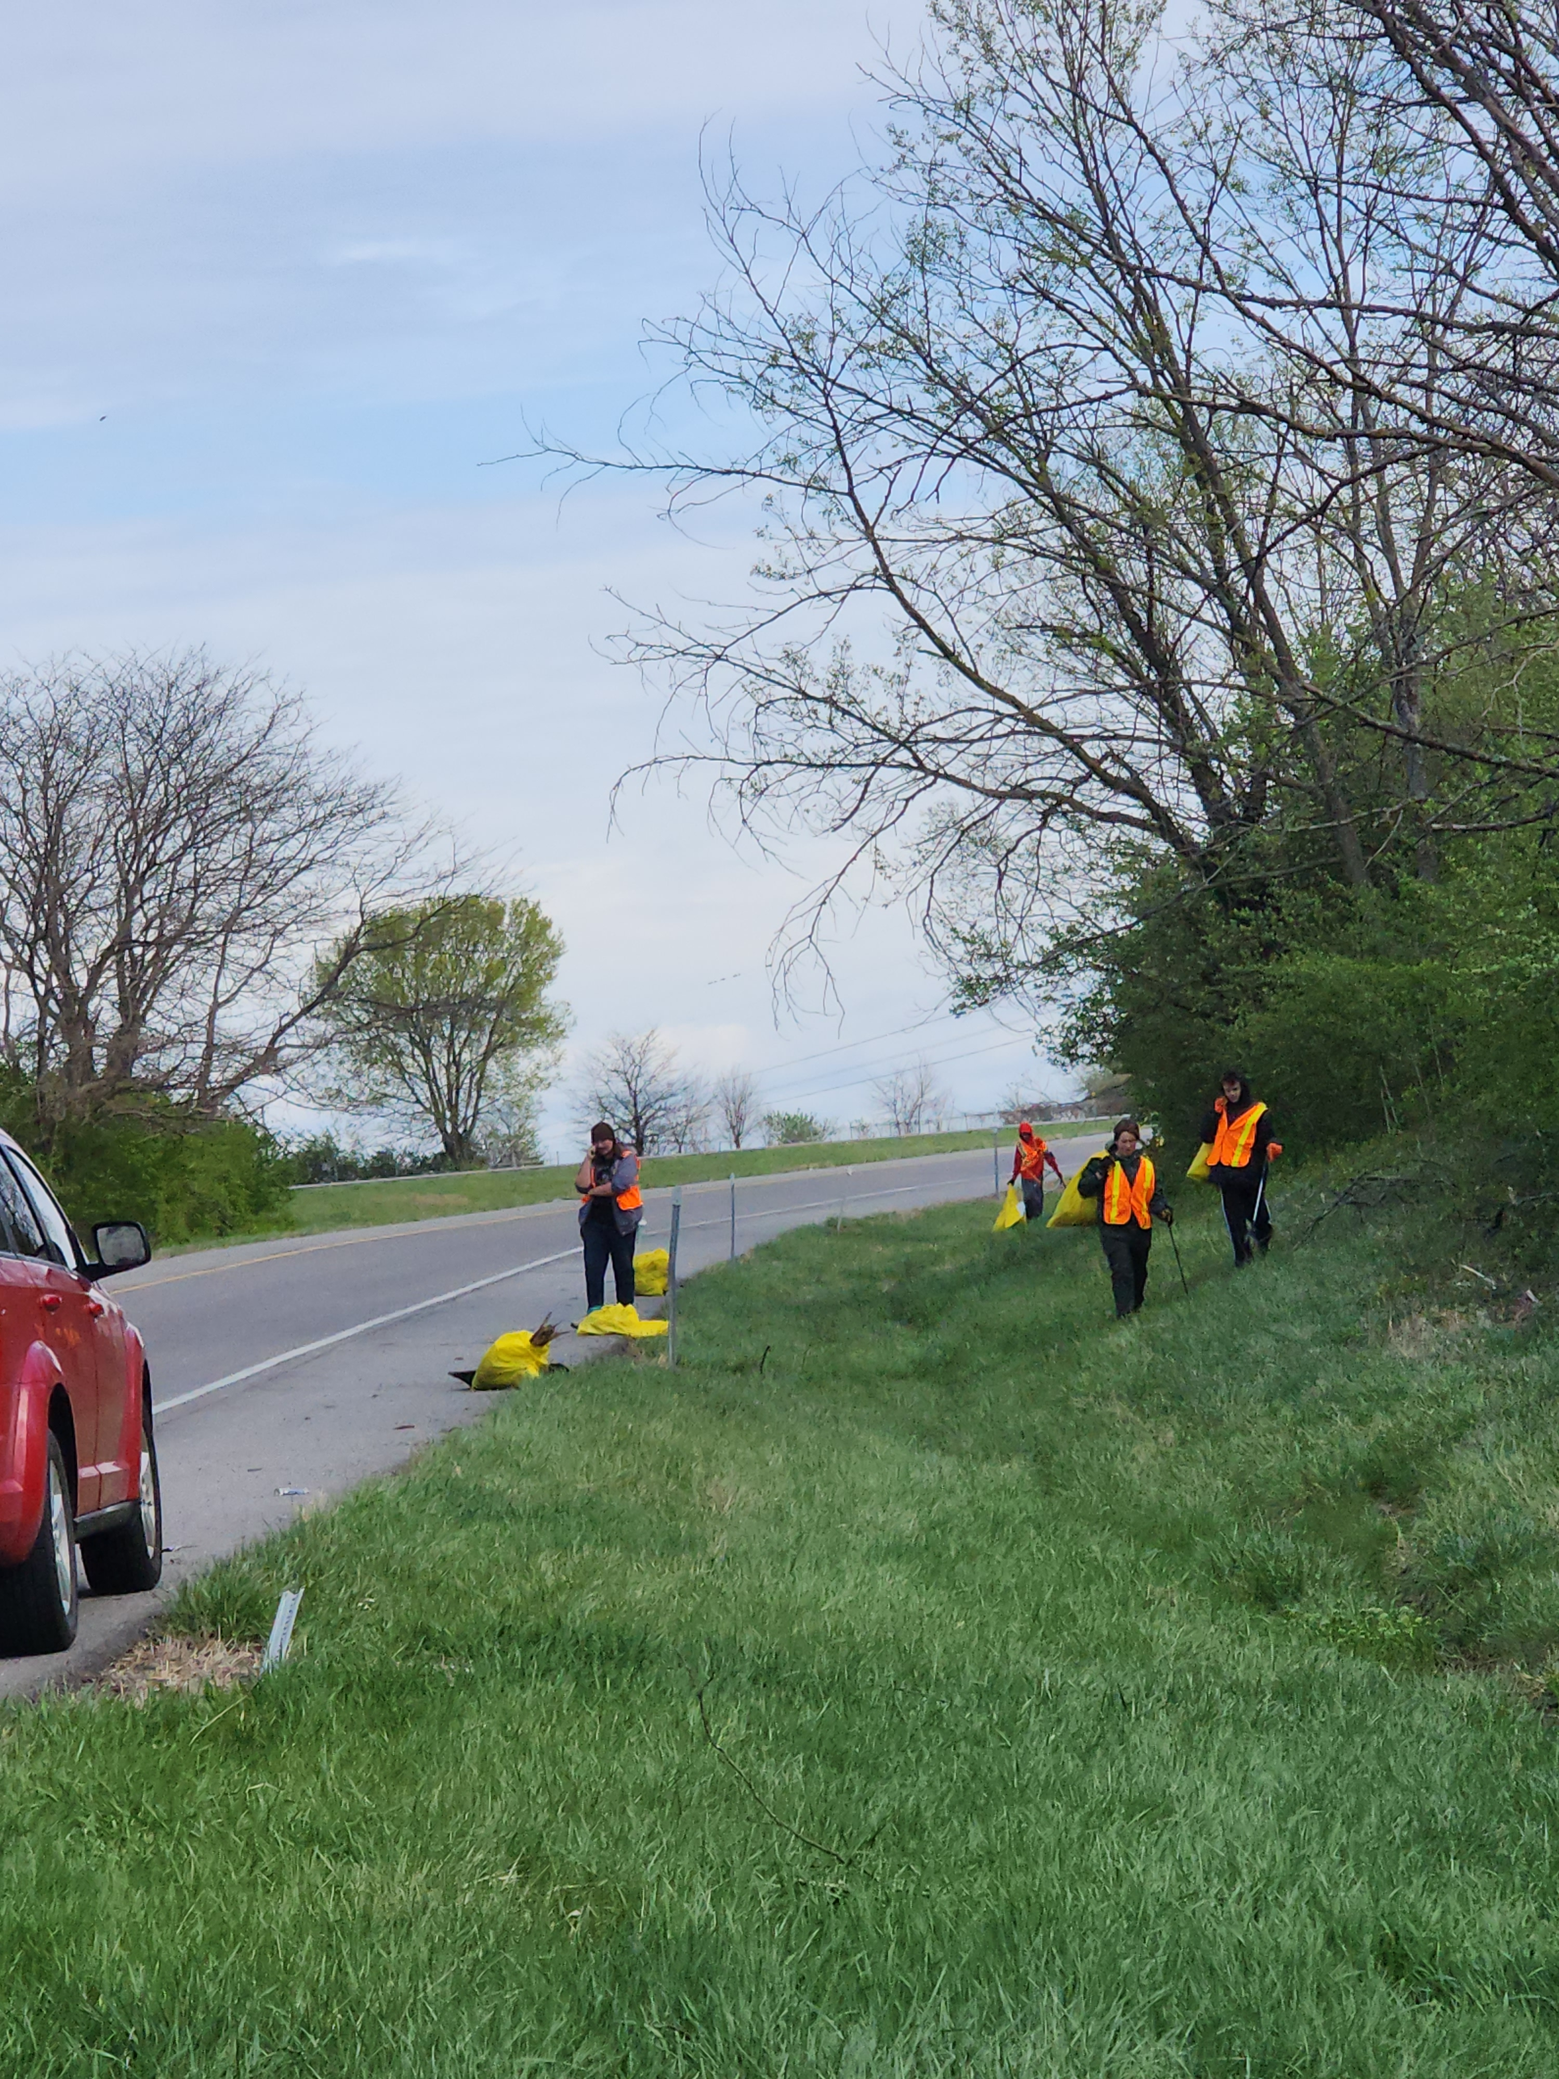
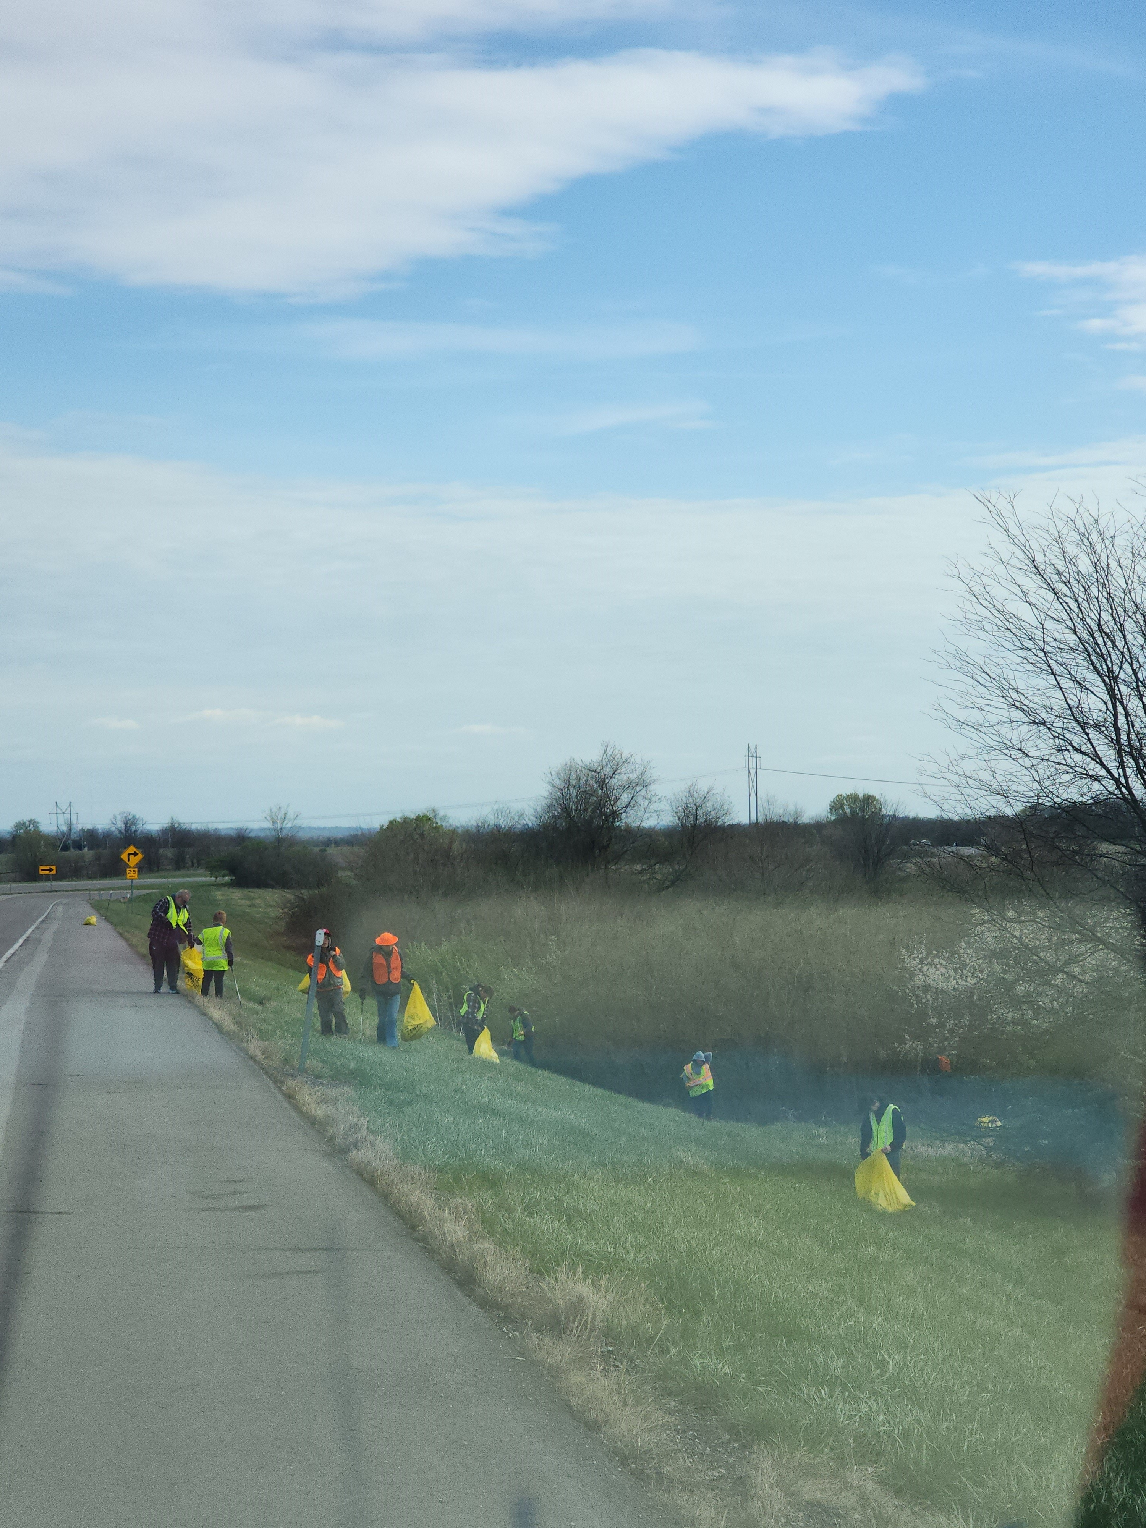
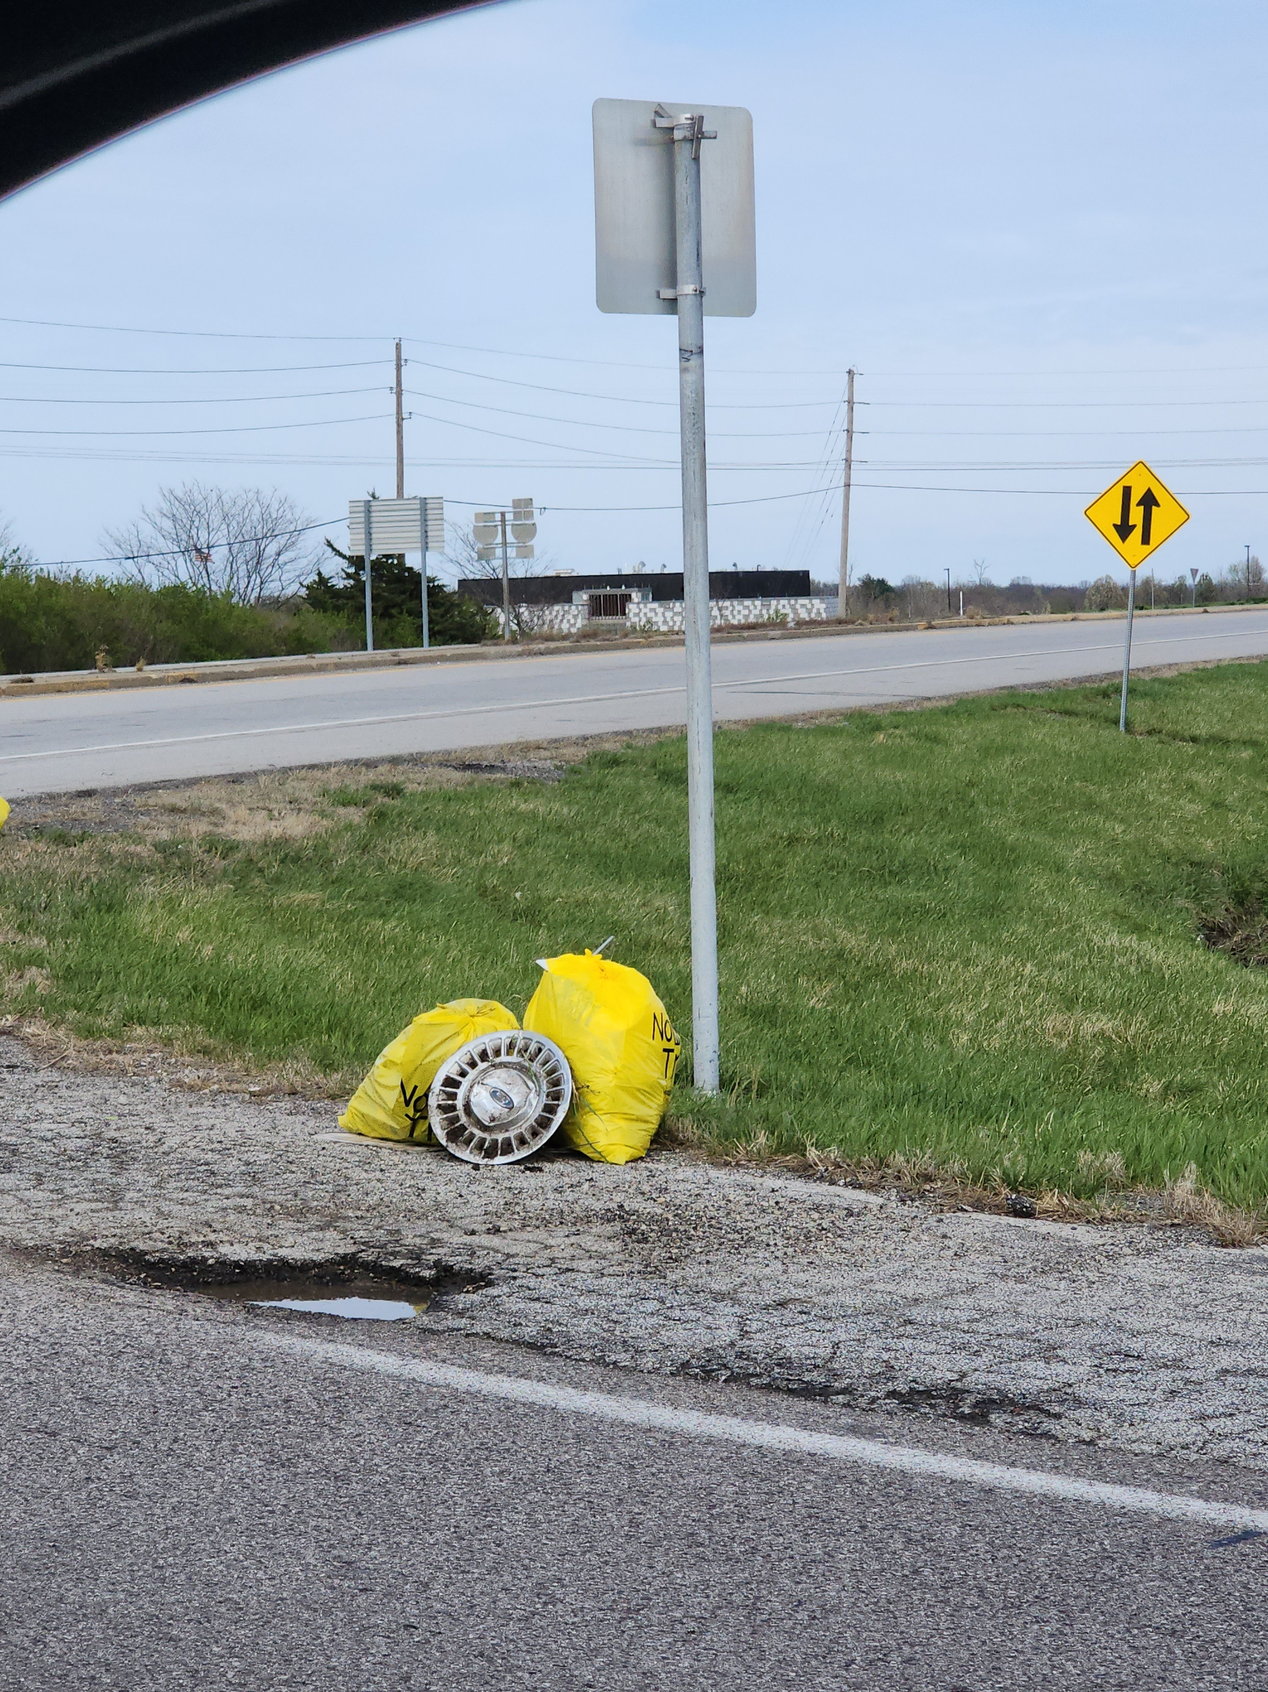
OA Service Project

Slide 16

Reminder
No food or drinks
In Sanctuary
Please keep them in the Lobby

