Slide 1
PAUSE
for
Neurodivergence
Katrina Carey, ASM Troop 222
thekatrinacarey@gmail.com
Katrina Carey, 2024

Slide 2
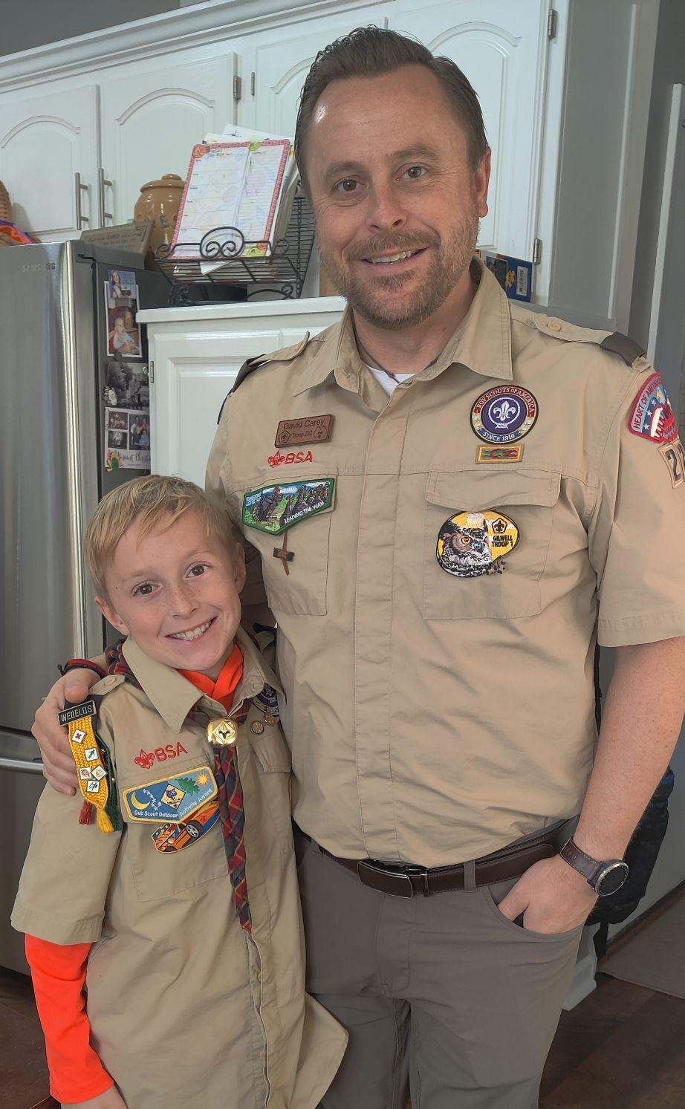
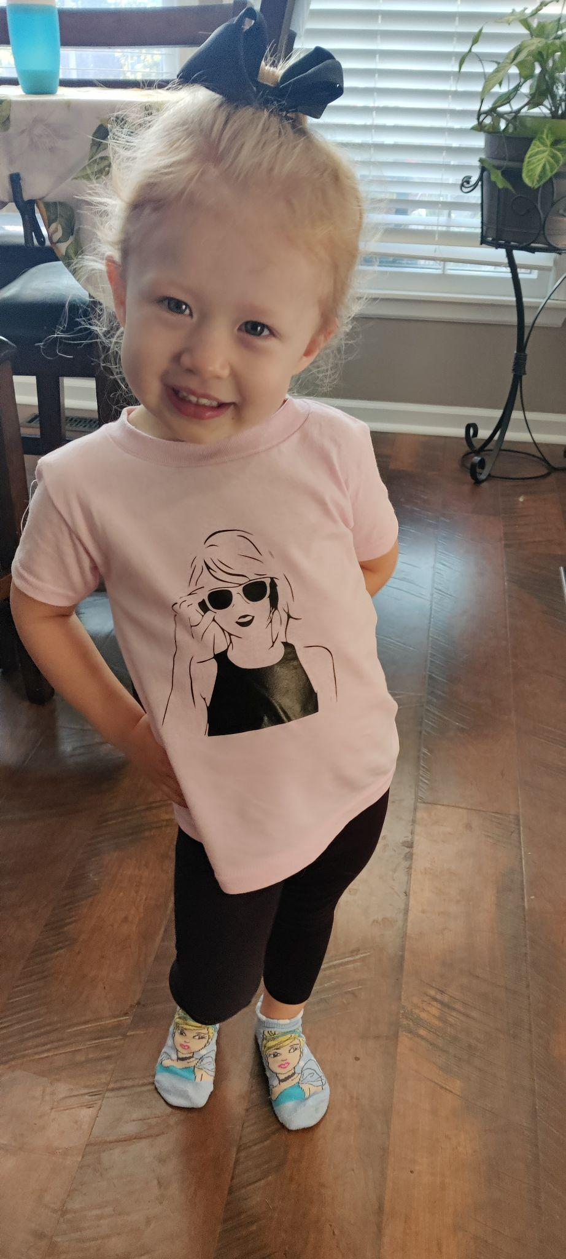
Meet my Scouts:

Slide 3
Session Goals
Understand what neurodivergence means.
Recognize some strengths and challenges of individuals who are neurodivergent.
Gain some skills to help neurodivergent individuals achieve success in your program.

Slide 4
But first…
a disclaimer.

Slide 5
What does it mean to be Neurodivergent?
Neurodivergence centers around the idea that as individuals our brains function differently. This includes how we take in information (i.e. learning) and how we perceive the environment around us.
https://my.clevelandclinic.org/health/symptoms/23154-neurodivergent

Slide 6
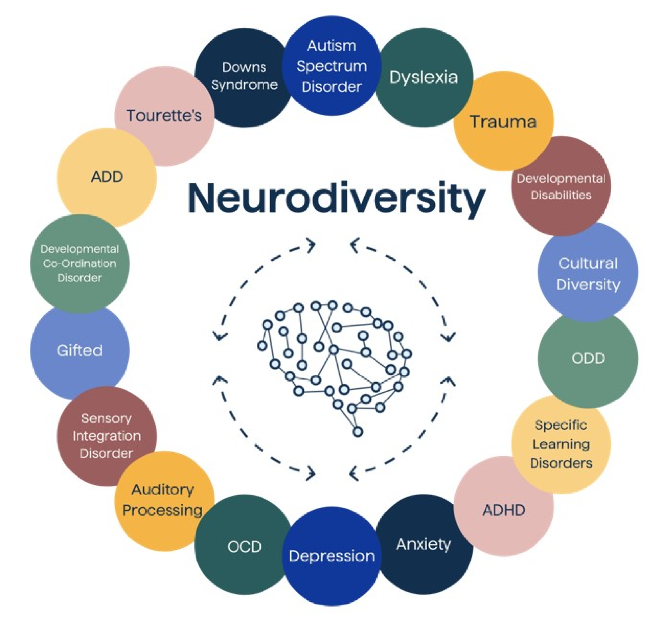
The rainbow infinity symbol represents the infinite potential and diversity of the neurodivergent community, reflecting the unique strengths and qualities of each individual.
https://images.app.goo.gl/JeK14y4AupKhRR598

Slide 7
Strengths of Neurodivergence:
-Unique or specialized skill set
-Innovative “out of the box” thinker
-Creative
-Detail oriented
-Intense concentration
-Able to identify trends/patterns
https://blog.alludo.com/5-strengths-neurodivergent-employees-bring-to-the-workplace/
Notes:
Bill Gates, Greta Thurnburg, Simone Biles, Albert Einstein, Emma Watson, and Steve Jobs are just a few examples of neurodivergent individuals.

Slide 8
“A neurodivergent person is often described as a high-energy, out-of-the-box thinker and bold problem solver with above-average pattern recognition.”
–CTI Working Environments

Slide 9
Challenges of Neurodivergence
-Sensory processing differences
(the five senses; but also including interoception–the signals from inside the body; and proprioception–awareness of the body in space)
-Struggles with certain executive functioning skills
(cognitive flexibility, inhibitory control, and working memory)
https://theeducationhub.org.nz/key-challenges-for-neurodivergent-students-in-school-settings-and-how-to-help/

Slide 10
Challenges Related to Mental Health
Research indicates that neurodiverse students are more likely to experience additional mental health conditions, including emotional distress, depression, and anxiety[3,4]. These conditions can manifest because of their difficulties in managing their neurodiverse conditions[5-7].
-World J Psychiatry. 2024 Nov 19
Notes:
The combination of social, emotional, and educational challenges, along with the lifelong persistence of these issues, puts neurodiverse students at a heightened risk[10,11]. As a result, they have difficulties coping with normal conditions of life, especially when they are exposed to stressful events.
https://pmc.ncbi.nlm.nih.gov/articles/PMC11572678/#:~:text=Research%20indicates%20that%20neurodiverse%20students,conditions%5B5%2D7%5D

Slide 11
PAUSE
When working with neuro-divergent scouts I invite you to PAUSE:
P - Plan.
A - Accommodate.
U - Understand uniqueness.
S - Set the scene.
E - Express empathy.

Slide 12
PLAN
ACCOMMODATE
Plans/schedules provide a framework of expectations. However, flexibility and transitions can be difficult for neurodivergent individuals.
Allow for movement and provide choices.
Ask the parents/guardians, or the scout themself for the types of accommodations they might need.

Slide 13
Neurodivergent individuals are unique in their gifts and challenges.
Strategies that work for one scout may not work for another.
Be patient, ask questions, and withhold judgments.
UNDERSTAND UNIQUENESS

Slide 14
EXPRESS EMPATHY
SET THE SCENE
Recognize their situation, listen to what they need to share, and then give them a safe space to process their feelings and let them rejoin the group when they are ready.
Sensory input can be overwhelming and can cause a scout to become dysregulated.
Having a separate location for a scout to calm down when overstimulated can be very helpful.

Slide 15
How can you apply PAUSE in each of these scenarios?
URIAH’S UNIFORM
The campout schedule said that dinner was supposed to be at 6pm and the campfire program at 7:30pm. It is 6:15pm and the scouts haven’t started cooking yet. Carly, who is leading the campfire, is pacing, becoming irritable with her peers and keeps asking “how many more minutes” dinner will take.
CARLY AT THE CAMPOUT
Uriah is not in his uniform AGAIN. You ask him about it, but he just shrugs. You remind his parent at pick up, but his mom said it is a huge battle because it is stiff and scratchy.
MIKE AND THE MEAL PLAN
Mike volunteered to shop for this weekend’s campout. After the meeting you find his shopping list laying on the table, again. It seems that Mike is ALWAYS misplacing things. He wants a leadership position, but he isn’t showing responsibility.

Slide 16
URIAH
MIKE
CARLY
REMEMBER:
Understanding the uniqueness of each individual and working together to meet their needs is the key to achieving success in scouting.
Mike my need some additional accommodations to provide a framework of your expectations.
Checklists, alarms on his phone, or a buddy to help him stay accountable could all be worthwhile strategies to try.
Make an accommodation. It is more important to have him participating than dressed in full class A.
Maybe work towards adding a piece each week, or wearing it for the first few minutes and building up to the full meeting time.
Carly needs empathy. Acknowledge that the plan changed. Set the scene with a space for her to calm down. Reassure her that her campfire program is still a priority.

Slide 17
SCOUT
https://images.app.goo.gl/NpSxrQ1dUCRv8ygq9

Slide 18
Thank you for opening your mind to understanding Neurodivergence!
Contact me:
thekatrinacarey@gmail.com
For more information explore the additional resources.

Slide 19
Thank you SlidesGo!
For more information about editing slides, please read our FAQs or visit Slidesgo School:
https://slidesgo.com/faqs and https://slidesgo.com/slidesgo-school

