Slide 1
SONS OF THE AMERICAN REVOLUTION
EAGLE SCOUT RECOGNITION PROGRAM

Slide 2
Ernie Wasmer
CONTACT INFORMATION
E-MAIL: APTINC@YAHOO.COM
PHONE: 816-589-2220
ALSO: ALAN SANDERS AT THE SCOUT HEADQARTERS.

Slide 3
RECOGNITION
SAR EAGEL SCOUT CERTIFICATE
SAR EAGLE SCOUT PATCH
SAT EAGEL SCOUT MEDAL

Slide 4
NSSAR AWARDS
Essay contest
NATIONAL FIRST PLACE WINNER $10,000.00
FRIST RUNNER UP $ 6,000.00
SECOND RUNNER UP $ 4,000.00

Slide 5
ATHRUR M. AND BERDENA KING EACLT SCOUT CONTEST
APPLICATION CONSISTS OF THREE PARTS
  EAGLE SCOUT CONTEST APPLICATION FORM
  FOUR GENERATION ANCESTOR CHART
  500-WORD PATRIOTIC THEMED ESSAY
  DEADLINE FOR THE CONTEST 15 FEBRUARY

Slide 6
ESSAY SUGGESTONS
EVENTS
    EVENTS LEADING UP THE REVOLUTION, e.g. Boston Massacre, Boston Tea Party
    PERSONS:
      MEMBERS OF THE CONTINENTIAL CONGRESSES
      SERVICE MEMBERS
    PHILOSOPHY OF IDEALS
    FOUNDING DOCUMENTS

Slide 7
EXAMPLES OF PAST WINNERS
HTTPS://WWW.SAR.ORG/ARTHUR-M-BERDENA-KING-EAGLE-SCOUT-CONTEST/
CLICK ON: Winning Eagle Scout name

Slide 8
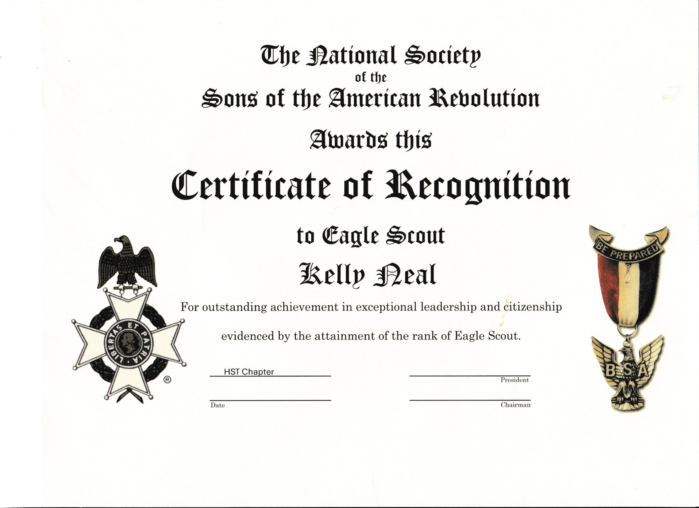

Slide 9
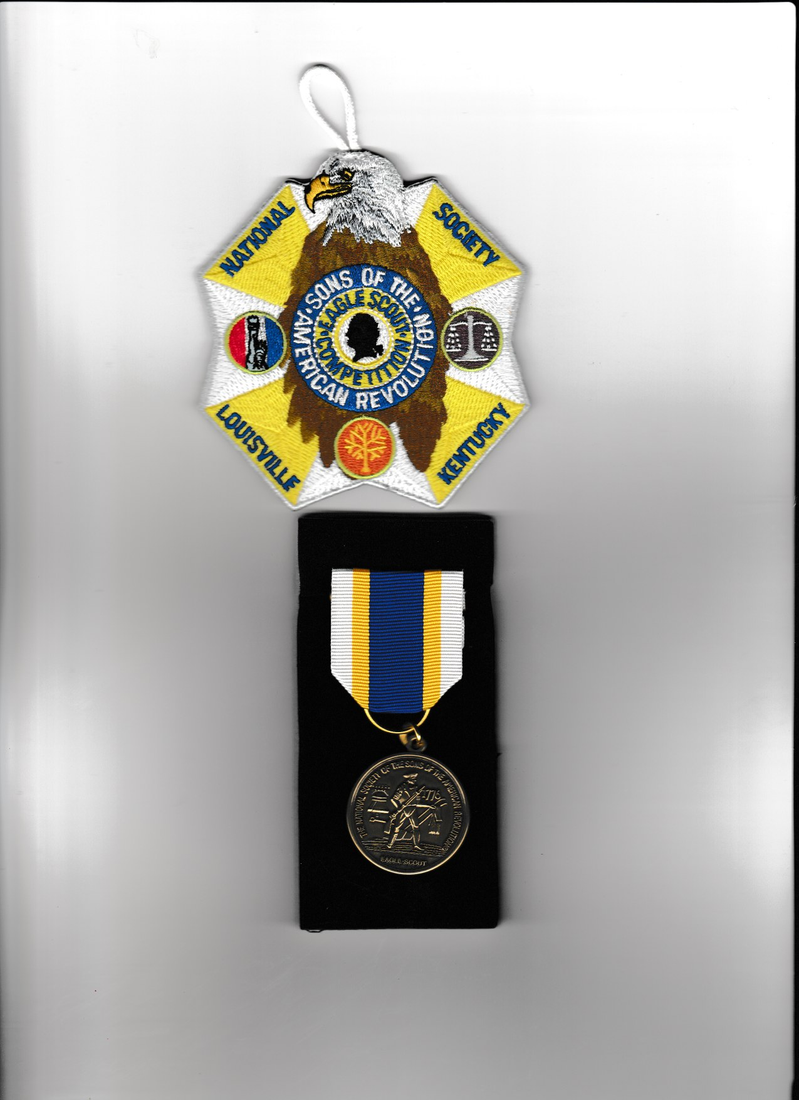

Slide 10
Sons of the Union Veterans of the Civil War
Form to complete
Certificate
Patch
The National Chapter will provide the Certificate and the Patch
I can e-mail you the Form

Slide 11
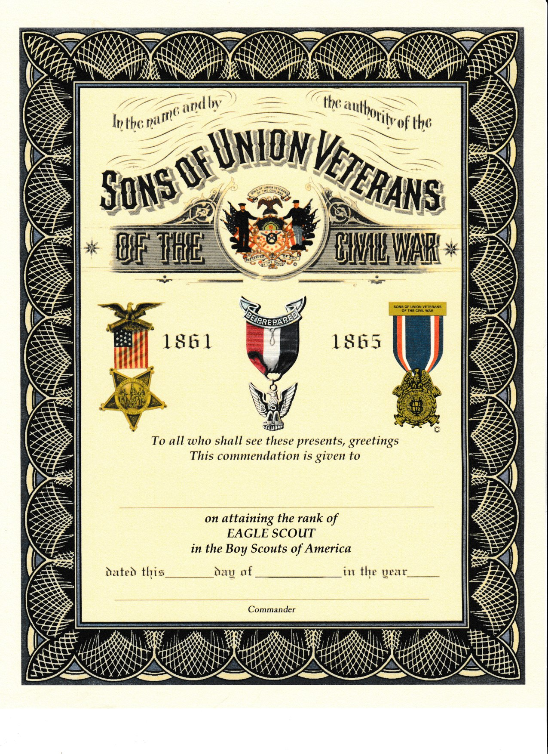

Slide 12


Slide 13
If you are interested
The best thing to do is contact me and I will email you all the forms.
Email: aptinc@yahoo.com
  With the e-mail please note the Eagle Scout Recognition and the Troop Number
    This allows me to be certain that this is not spam or worse
Cell: 816.589.2220

Slide 14
Thank you for your time
Any questions.

