Slide 1
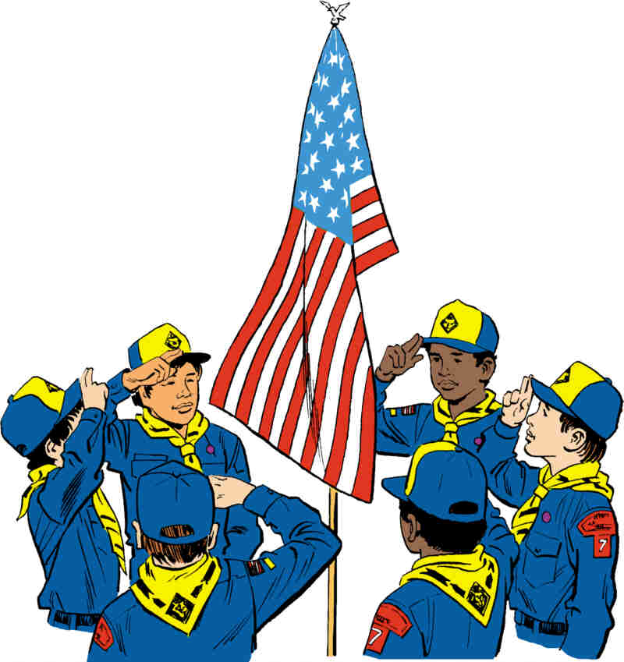

Roundtable Youth Flag Ceremony
Troop/Pack Youth Flag Ceremony
  Pledge, Oath, Law & Outdoor Code
First / Second time participant receives red/white/blue star coups
Third time participant receives red/white/blue loops
See Gail Lavenburg to signup
  816-682-5875, gaill0516@gmail.com
A big thank you to Janet Cookinham for donating the ribbon & sewing the loops!

Slide 2

Help Needed!
DISTRICT CUB SCOUT
ADVANCEMENT CHAIR NEEDED!
If you are interested in applying, contact Ron Adams tonight in the Eagle Project Review area, or by email at SGMRON13250@HOTMAIL.COM

Slide 3

Nominate someone for SOTM
Nominate a worthy Scouter for Scouter of the Month!
If you know a Scouter who has gone above and beyond, get them recognized at Roundtable.
They need not be active at the District or Council level to receive this award.
To nominate someone, go to the Roundtable website:
https://www.northstarkc.com/roundtable
Scroll all the way down and fill in each field.
Please note that only nominations received via the website will be accepted.

Slide 4

UPCOMING ACTIVITIES
North Star District
(Sat) 05-Apr-2025 OA - Spring Service Project & Call-Out (Sat Day)
(Sat) Sep/Oct-2025 Fall Cub Family Camp-Out (Fri Night/Sat Day)
(Sat) Sep/Oct-2025 Camp-O-Ree & Webelos Woods (Fri/Sat/Sun)
HOAC
(Fri) 11-Apr-2025 Hike-A-Palooza
(Fri) 25-Apr-2025 OA Spring Induction
(Sun) 27-Apr-2025 Scout Day at the "K"
(Tue) 29-Apr-2025 BSA Patron Event
(Sat) 30-Aug-2025 Scout Night at the Monarchs
(Sat) 08-Nov-2025 Scout Night at the Zoo

Slide 5

UPCOMING TRAINING

Slide 6
UPCOMING TRAINING (CONT.)

Slide 7

UPCOMING TRAINING (CONT.)
BALOO – March 22-23 – Camp Naish
Wilderness First Aid – March 22 – Camp Naish
Spring IOLS 1 – April 4 – 5 – Camp Naish
Wilderness First Aid – April 5 – Camp Naish
Philmont Training Day – April 11 – 13 – Camp Naish
Wilderness First Aid – April 26 – Camp Naish
Leave No Trace – May 2 – Camp Naish
https://mycouncil.hoac-bsa.org/Program/36

Slide 8

UPCOMING TRAINING (CONT.)
Other training courses available:
  Shotgun Instructor NRA Training
  Pistol Instructor NRA Training
  Range Safety Officer NRA Training
  Basic Instructor NRA Training
  Leave No Trace Level 1 Instructor
  Chainsaw Training
  For all the above courses, go to:
  https://mycouncil.hoac-bsa.org/Program/36

Slide 9

May Meeting
Thursday, May 1
Sign-in at 6:30
Program begins at 7:00
At the Salvation Army Northland Corps & Community Center

Slide 10

Reminder
No food or drinks
In Sanctuary
Please keep them in the Lobby

