Slide 1
Bryan Karr – Platte County Zone Membership Chair
Sign-up for Scouting Coordinator
Marjorie Manzo – North Star Vice Chair of Membership
New Member Coordinator
Does your unit have this position?

Slide 2
What is a New Member Coordinator (NMC)?
New Member Coordinator is a BSA unit adult position whose purpose is to welcome youth and their families and help them become truly engaged in Scouting so that they feel a strong sense of belonging.
All Units are encouraged to have this position
Appointed by Unit Committee Chair (or Unit Leader)
Is supported by District Membership Chair (Marjorie Manzo)
Make this position your own!

Slide 3
About Roles of NMC
They share the benefits of scouting, coordinate unit recruitment, and guide the joining and welcoming processes. New Member Coordinators are invited to choose one or more areas of personal focus based on their own interests and the needs of the unit. A job description gives more information.
Serve as welcoming ambassadors for the unit.
Work with the unit committee in developing and implementing the Unit Membership Plan.
Participate in New Member Coordinator training and collaborate with the district membership team.

Slide 4
Specific responsibilities for NMC
Roles Determine by Unit
1. Share Your Story of Scouting, Social Media Promotion, and Showcase Scouting through engagement in local community events and service.
2. Unit Recruitment.
A. Oversee unit recruitment efforts such as joining events, informational presentations, and peer-to-peer initiatives.
B. Appeal to potential youth members and their families through well-designed and widely distributed invitations shared through electronic media, handouts, and personal contacts.
C. Ensure that the unit’s BeAScout pin is up-to-date and that prompt follow-through takes place.
D. Collaborate with local school representatives and community leaders, particularly in the chartered organization, to foster promotion of Scouting opportunities.

Slide 5
Specific responsibilities for NMC (Cont.)
  3. Guide the joining and welcoming process for youth and their families.
a. Help youth and adults to greet newcomers warmly and to establish friendly, enjoyable relationships so that new members form a strong sense of belonging.
b. Develop a unit welcome packet, electronically and/or in print, to answer frequently asked questions and to provide resource and contact information.
c. Ensure that youth and adult applications, transfers, and payments are promptly submitted to the council service center.
d. Build fun and excitement about the unit program and encourage youth and their families to take pride in Scouting accomplishments.
e. Promote feedback and sharing of ideas through customer satisfaction surveys and other means.

Slide 6
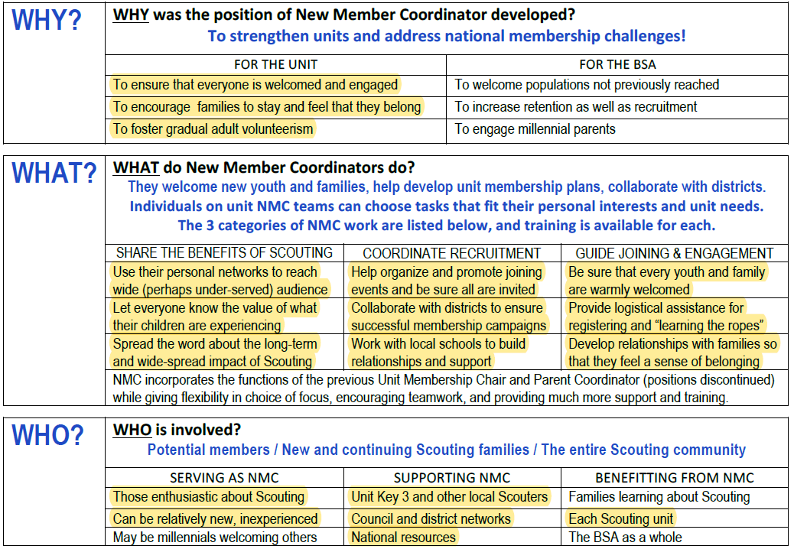
Why, What, Who, and How

Slide 7
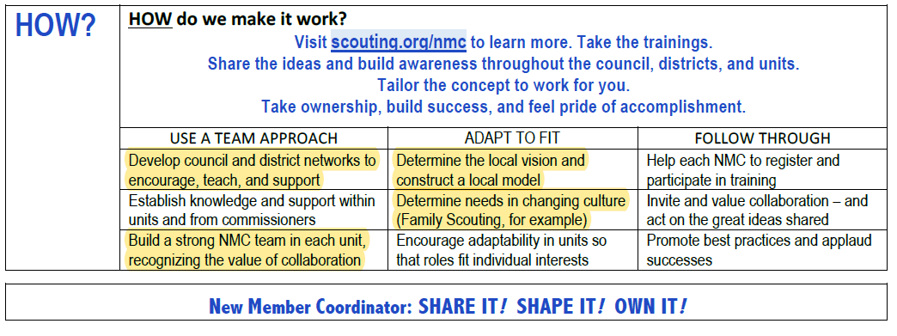
Why, What, Who, and How (Cont.)

