Slide 1
KCPD Explorer Post #8600

Slide 3
PURPOSE
Giving youth an opportunity to explore law enforcement to see if they would like to pursue Law Enforcement as a career.
A vehicle for community interaction and mentoring.
Showcasing KCPD as an organization.
Recruitment of Youth from all the people of KC.
Encouraging youth to join us in a Law Enforcement or non-sworn capacity.

Slide 4
Requirements for Membership in the Post
Must be between 14-20 years old (all genders).
Must live in a school district that is within the borders of Kansas City, Missouri.
Must maintain a 2.0 grade point average.

Slide 5
KCPD Explorer Post #8600
Our first law enforcement Explorer Post started in 1971 (Chief Kelly).
Other versions sprung up in the early 1990s in Metro and East Patrol.
Planning for this post began in 2018
Chief Smith and IACP Meeting in Philadelphia.
Heart of America Council BSA approached Chief Smith to start a post.
Numerous planning meetings with HOAC, DC Oakman (Ret), Major Wayne Stewart (Ret), and myself.
All leaders completed Youth Protection Training.
First actual Explorer meeting was 9/11/2019.

Slide 6
Funding
Our post is funded by KCPD.
We pay for the following items:
Registration Fees for KCPD adult leaders
Overtime to facilitate the program (the meetings)
Uniforms
Long Sleeve uniform shirt
Short Sleeve uniform shirt
Tie
Collar Brass
Nametag
Sewn on Explorer Badge and Post shoulder patches
Black leather belt
Trousers
Explorer T-Shirt
Explorer Youth are expected to provide the following items:
BSA registration fee of $45. Financial assistance is available if needed.
A pair of black socks.
A pair of plain black shoes or boots.

Slide 7
OPERATION OF THE POST
Our post is operated entirely by KCPD
We have several volunteer KCPD officers who serve as leaders and mentors.
We get input from our Explorers on topics that interest them and that they want to learn about.
A leadership committee then selects the topics and organizes the meetings. This includes determining locations and getting assistance from officers who work in those units to present.

Slide 8
Meetings
We meet every other Thursday from 1830-2000.
We meet year around (except on holidays).
Our home base is South Patrol Division. A majority of the time we are at SPD but we meet where the topic takes us (Academy, Crime Lab, HQ, Etc.)

Slide 9
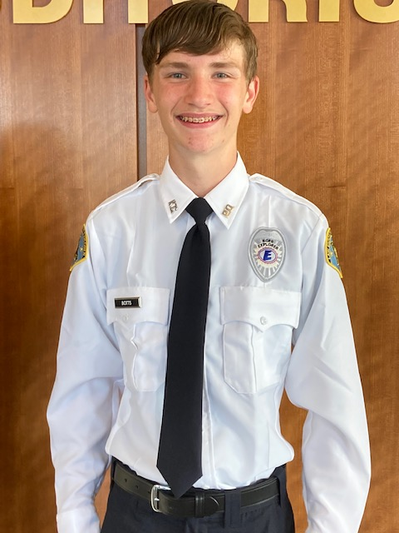
The Post Leadership Chose the Uniform with Chief Smith’s Approval.

Slide 10
We designed our own Badge and shoulder patch

Slide 11
We designed our own T-Shirt.

Slide 12
ACTIVITIES/TOPICS we have done
Bomb and Arson
Tactical Response Teams
Driving Track
Radio Procedures
Crime Lab
Uniforms/Formal Roll Calls
Operation 100’s- Command Post, Hostage Negotiations, Drones
Gang
Traffic Control
Canine

Slide 13
ACTIVITIES/TOPICS we have done
Traffic Unit/Radar
Helicopter
Field Searches/Cadaver Dogs
Radio Procedures/Car Stops
Discussion on Use of Force
ICAC Task Force
Building Searches (Simulation House, Parking Garage)
Fingerprint ID
Crime Scenes (with crime scene techs running simulated scenes)
City Court (Judge Bland)

Slide 14
ACTIVITIES/TOPICS we have done
Modified Ride-alongs
First Aid/CPR
Handcuffing
VIRTRA
Firearms Safety
Academy Class- Observation of PIEs
Stop Sticks
DUI Enforcement
Mental Health/Crisis Intervention Team
Homicide

Slide 16
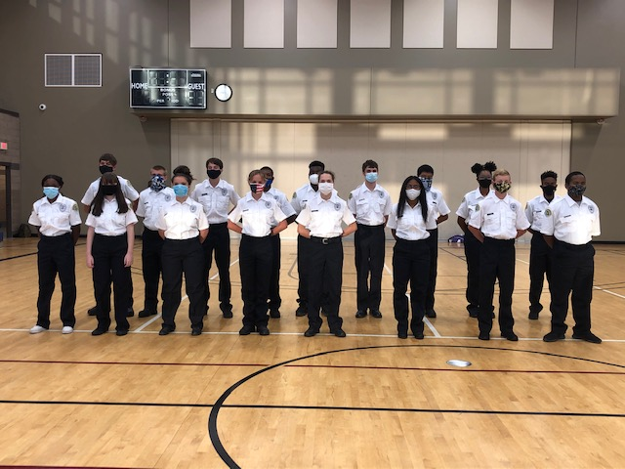
Explorers on Uniform Issuance Day

Slide 17
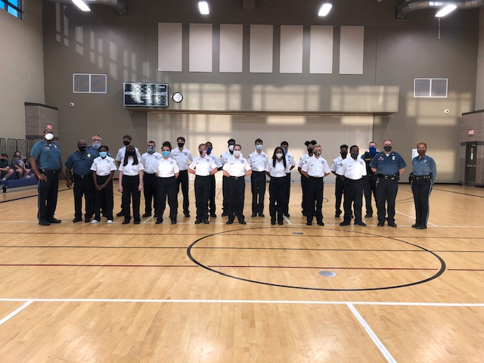

Slide 18
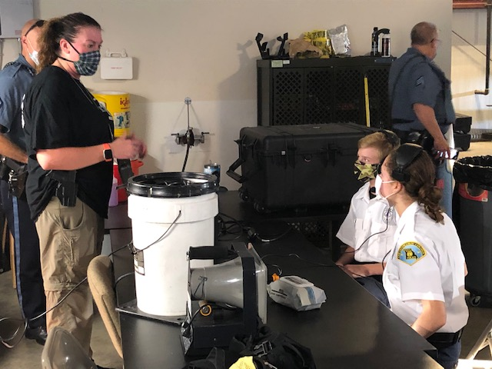
Hostage Negotiations

Slide 19
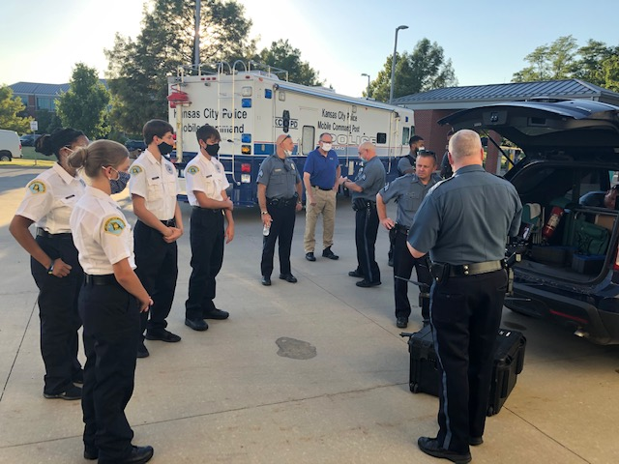
Operation 100 Drones and the Command Post

Slide 20
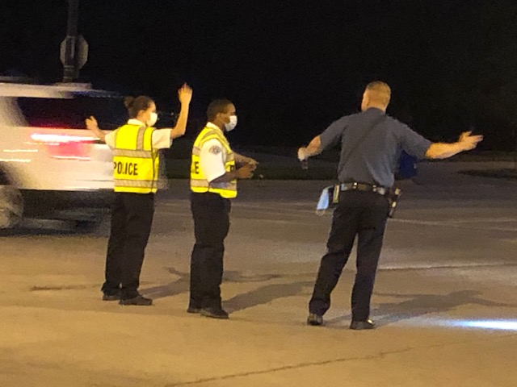
Traffic Control

Slide 21
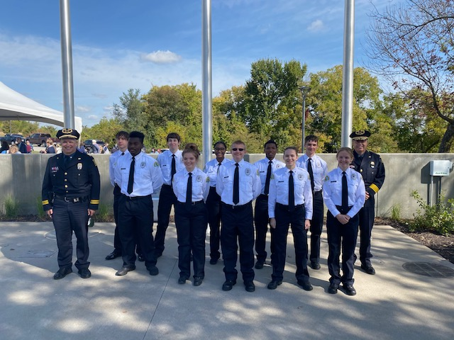
Law Enforcement Memorial Dedication

Slide 22
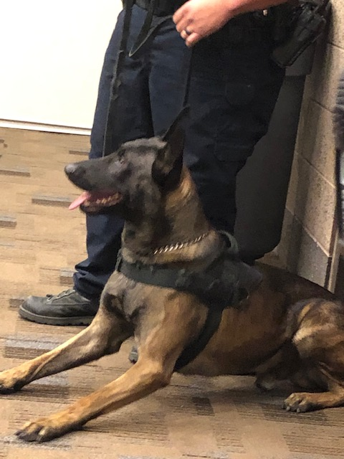
Canine

Slide 23
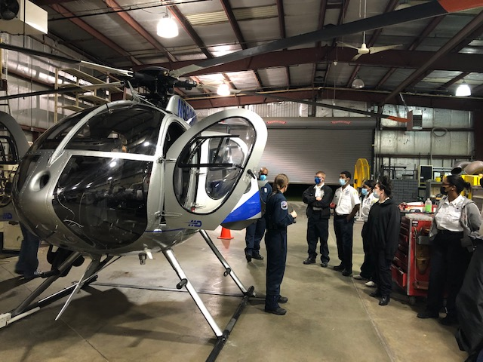
Helicopter Unit

Slide 24
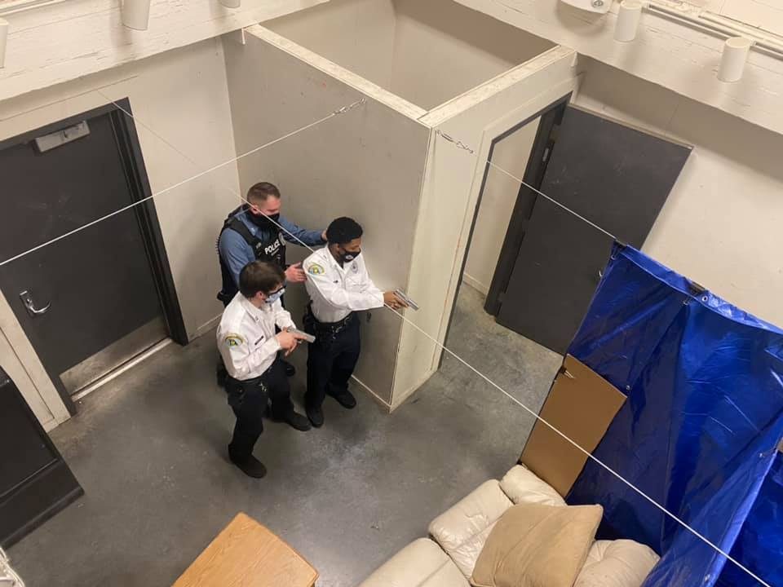
Building Searches

Slide 25
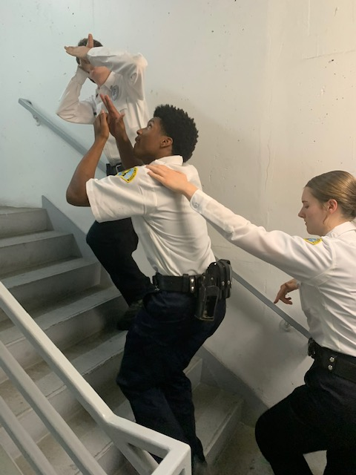
Building Searches

Slide 26
Vehicle Stops/Radio Procedures

Slide 27
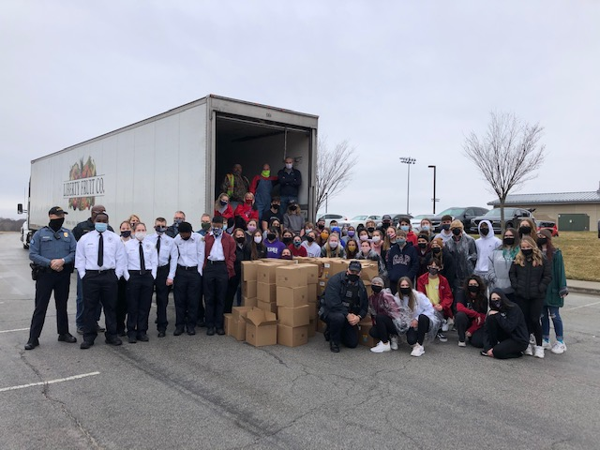
USDA Food Giveaway During Pandemic

Slide 28
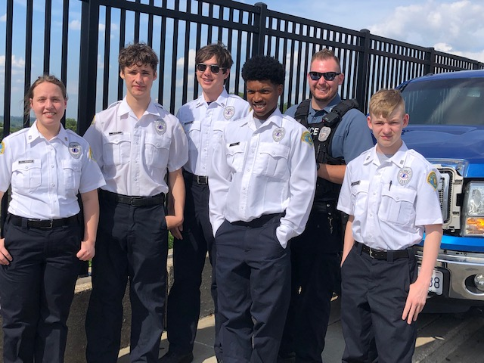
Ridealongs

Slide 29
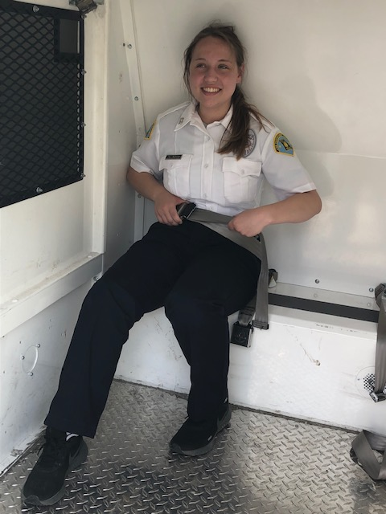
Ridealongs

Slide 30
DUI- Drunk Driving Simulation

Slide 31
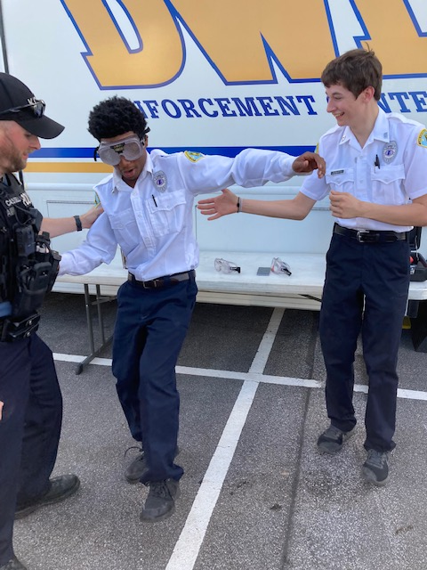
DUI- Drunk Driving Goggles- FST

Slide 32
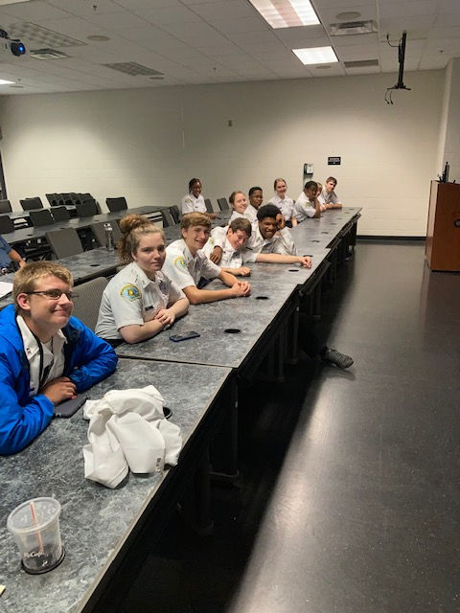
Firearms Safety

Slide 33
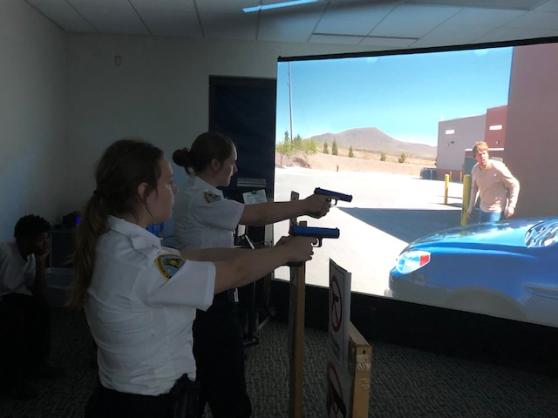
VIRTRA

Slide 34
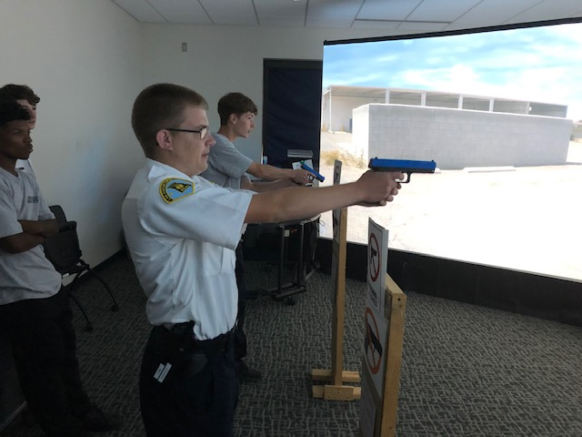
VIRTRA

Slide 35
Handcuffing

Slide 36
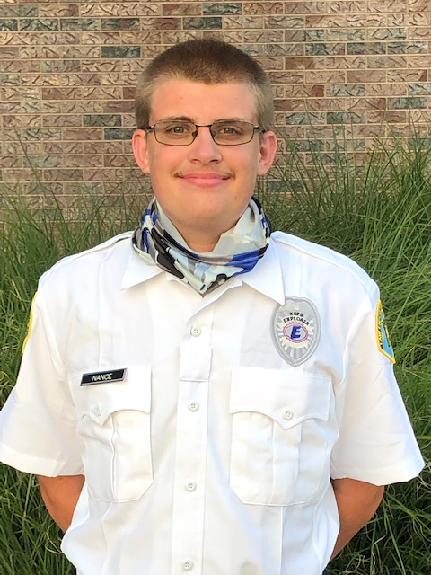
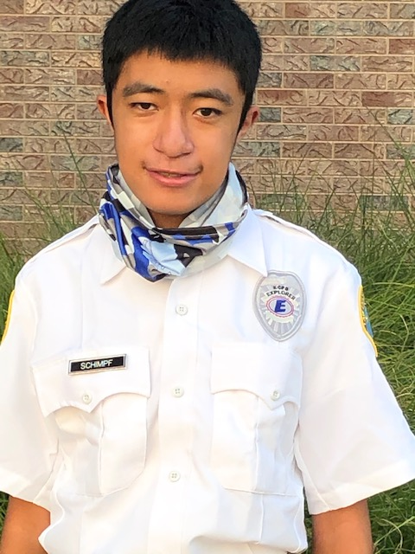
INTRODUCTION OF Eagle Scouts/Explorers Nathan Nance and Creed Schimpf

Slide 37
Questions?
THANK YOU!

